Slide 1
Effective Formative Assessment
Mark Levesley

Slide 2
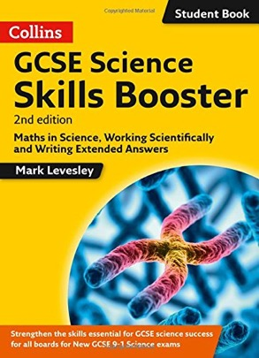
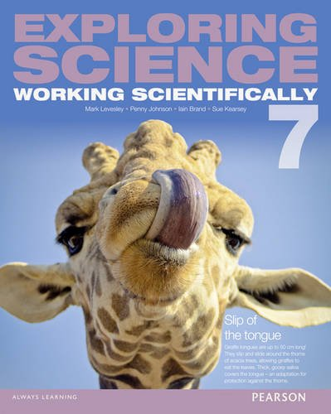
Introductions
Mark Levesley
Science Education Writer
Notes:
Mark Levesley is a science education writer based in the UK, and also works as a series editor. This involves planning how a course of books work, including the assessment.

Slide 3
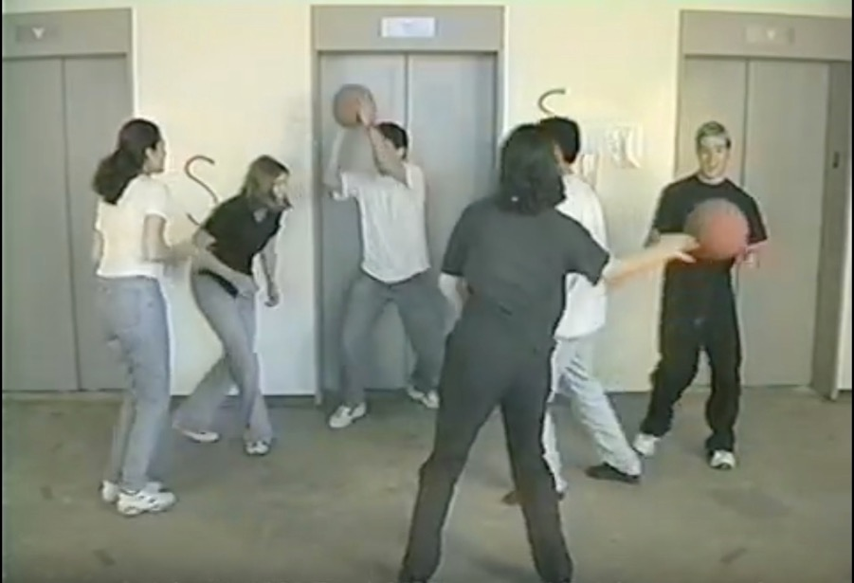
A few questions
A1
Hands up!
Have you seen this video?
Notes:
Copyright Viscog Productions.

Slide 4
A few questions
A2
Multiple choice
Another term for formative assessment is:
A summative assessment.
B assessment for learning.
C assessment of learning.
D ipsative assessment.

Slide 5
A few questions
A3
Rate 0, 2 or 5
How confident are you that you answered question A2 correctly?
0 – My answer was a complete guess.
3 – I’m not sure but I think I’m correct.
5 – I’m very sure that I’m correct.

Slide 6
A few questions
A4
Longer answer
What is the purpose of formative assessment?
____________________________________________________________________________________________________________________________________________________________________

Slide 7
A few questions
A5
Using emoticons
How much did you enjoy answering question A4?

Slide 8
The purpose of assessment
What is the purpose of assessment?
To see if students have reached a required standard.
SUMMATIVE ASSESSMENT
To check that students are continuously developing knowledge and understanding.
FORMATIVE ASSESSMENT
To find out what level of understanding students have.
BASELINE ASSESSMENT

Slide 9
The purpose of assessment
Notes:
An analogy to think about and remember the different types of assessment: a swan swimming across a lake. The swan represents a student.

Slide 10
The purpose of assessment
SUMMATIVE ASSESSMENT
Aim
Notes:
Any ’learning episode’ needs aims/learning objectives. We find out where a student has got to using summative assessment.

Slide 11
The purpose of assessment
BASELINE ASSESSMENT
Aim
Notes:
We find out where the students start from in terms of knowledge/skills using baseline assessment.

Slide 12
The purpose of assessment
Aim
Notes:
We cannot use baseline or summative assessment to find out why progress is not being made.

Slide 13
The purpose of assessment
Aim
Notes:
Formative assessment is like peering under the water to examine how and why the swan is swimming in the way that it is.

Slide 14
The purpose of assessment
SUMMATIVE ASSESSMENT
BASELINE ASSESSMENT
Aim
FORMATIVE ASSESSMENT

Slide 15
The purpose of assessment
Three parts to successful assessment:
Assessment activity – many different methods
Feedback – information from the assessment going to the teacher and/or the student(s)
Action plan – planning and carrying out ways to address successes, failures and problems

Slide 16
The purpose of assessment
The process of assessment is analogous to climate control:
Set Temperature
Detection by thermostat
Action plan
Temperature
change

Slide 17
The purpose of assessment
The process of assessment is analogous to climate control:
Aims
Detection by assessment activities
Action plan
Feedback shows level of student understanding

Slide 18
Baseline Assessment
What is it?
An assessment of where a student is starting from in terms of:
Knowledge
Skills
Enjoyment
Why do we use it?
To inform the planning of a ’learning episode’.

Slide 19
Baseline Assessment
When do we use it?
At the start of a learning episode.
How do we use it?
Previous test scores
Individual questioning
Class questioning
Check lists
Multiple choice
Longer answers
Notes:
Example from Exploring Science: Working Scientifically (Pearson).

Slide 20
Baseline Assessment
AIMS
Assessment activity ideas
Previous test scores
Individual questioning
Class/group questioning
Check lists
Multiple choice
Longer answers
Feedback ideas
Verbal answers
Show of hands
Certainty of Response Index (CRI)
Emoticons
Alphanumeric data (grades, marks, percentages)
Action Plan Planning how to teach the ‘learning episode’.

Slide 21
Formative Assessment
Formative assessment is:
“frequent, interactive assessments of student progress to identify learning needs and shape teaching”
(Formative assessment: Improving learning in secondary classrooms.
Paris: OECD, 2005.)

Slide 22
Formative Assessment
Assessment activity
assessment of a students’ learning during the learning process
Feedback
to the teacher – identify students’ understanding and difficulties
to the student – identify areas for improvement & encourage improvement
Action plan
the teacher – plan further coverage of a topic
– give students ways of helping understanding
the student – understand and put into action ways to improve

Slide 23
Formative Assessment
Effective formative assessment:
does not involve marks or scores or grades
makes teachers and students think about how students reach answers

Slide 24
Formative Assessment
AIMS
Assessment activity ideas
Previous test scores
Individual questioning
Class/group questioning
Check lists
Multiple choice
Longer answers
Feedback ideas
Verbal answers
Show of hands
Certainty of Response Index (CRI)
Emoticons
Alphanumeric data (grades, marks, percentages)
Action Plan Planning how to teach the ‘learning episode’.
Notes:
For formative assessment we do not use previous test scores or feedback in the form of grades, marks, percentages etc.

Slide 25
Formative Assessment
Individual questioning
Try asking questions that don’t have a limited response:
“Show me the stages you would use to …”
Give students a choice of three or more possible answers and ask them to speak their thinking as they make their choice.
Give questions as statements for students to explain.
Notes:
Tips for questioning individual students in a formative way.

Slide 26
Formative Assessment
Individual questioning – example
What is the simple past of the verb ‘to catch’ in English?
“Show me the stages you would use to …”
“Show me the stages you would use to turn this sentence into the simple past: Adela catches Badah’s ball.”
Give students a choice of three or more possible answers and ask them to speak their thinking as they make their choice.
“Which of these is the simple past of the verb ‘to catch’: catched, caught, catching, catches, cart.”
Give questions as statements for students to explain.
“Explain how you know that the simple past of the verb ‘to catch’ is irregular.”
Notes:
Example of formative questioning. The direct answer (‘caught’) is secondary to how students are going about working out that answer. We want to promote deeper understanding of the concept and not allow students to rely on simple recall.

Slide 27
Formative Assessment
Class/group questioning
Try asking questions that don’t have direct answers
Try:
selecting students at random using software
asking the question to more than one student
allow thinking time
Notes:
Tips for questioning the whole class or a group of students in a formative way.

Slide 28
Formative Assessment
Group work
Question G1: ‘Describe how to use the analogy of a swan on a lake to identify the purposes of baseline, formative and summative assessment.’
Question G2: ‘A car has a maximum speed of 20 km/h. The aim is for it to go 100 km/h. Use this analogy to identify the purposes of assessment types.’
A – think about baseline assessment
B – think about formative assessment
C – think about summative assessment
Notes:
Group work to illustrate the importance of students in a group having a defined role within the group, so that the success of the group depends on the contributions by all the students.

Slide 29
Formative Assessment
Group work
Ensure that every person in a group is needed to ensure the success of the whole group
Ideas include:
each student has different information to take to the group
each student has a distinct role (e.g. timekeeper, scribe, chairperson, contribution-checker, artist)
each student writes a short report to say what they contributed, what the others contributed, what they learnt and how well the group worked
random reporter
Notes:
Group work is good for getting students to ‘open up’ and so work formatively with their peers. However, group work needs to be effective and students must work as a group and not just in a group.

Slide 30
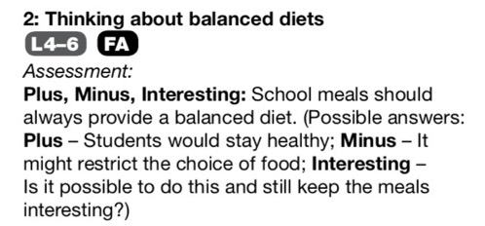
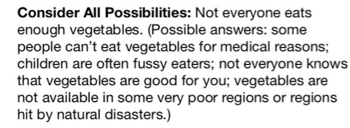
Formative Assessment
Group work
Ask questions that don’t have a limited response
Ideas include:
‘Explaining’ questions from a text book
Open-ended ‘Thinking skills’ questions
Notes:
Tips for groups to work on questions in a formative way.
Some text books have questions that are labelled with the skills that they involve. For example, in Edexcel IGCSE Biology (Pearson), questions labelled with ‘analysis’ or ‘reasoning’ are good ones for a group to answer. Look for questions that have command words such as ‘explain’ or ‘evaluate’, and break down the question so that students all have a defined role.
‘Thinking skills’ questions are open-ended questions that have more than one answer. Students need to try to come up with many different answers and so get used to the idea of thinking around a question, and thinking more deeply about what a question means, rather than imagining that every question has a definite answer that is right or wrong.
Example from Exploring Science: Working Scientifically (Pearson).

Slide 31
Formative Assessment
Check lists
Short (for formative assessment)
Vary how they are used:
emoticons
shading
CRI scales
develop your own scales
e.g. ✔️✔️ – I am confident of teaching the class about this
✔️ – I am confident about contributing to a group discussion about this
✖️ – I would rather work with someone else who knows a lot about this
Notes:
Tips for using check lists in a formative way.

Slide 32
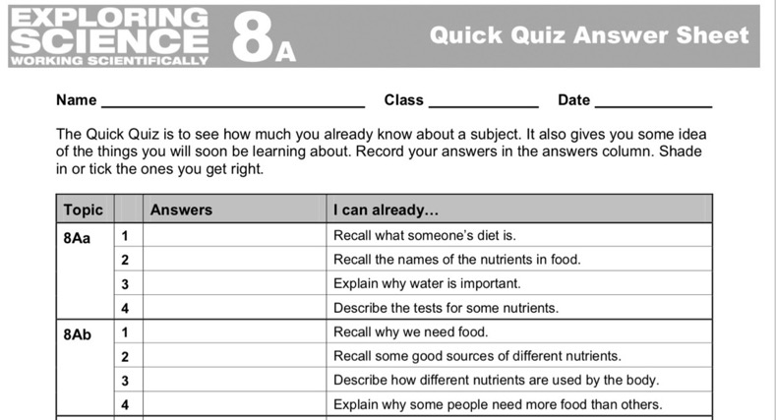
Formative Assessment
Multiple choice
Short (for formative assessment)
Consider answer sheets
Vary how they are used:
emoticons
shading
CRI scales
develop your own scales
Notes:
Tips for using multiple choice questions in a formative way.
Example multiple choice answer sheet from Exploring Science: Working Scientifically (Pearson).

Slide 33
Formative Assessment
Multiple choice
Topic | Q | Answers | I can …
8Aa | 1 | B 😊 ✔️ | Recall what someone’s diet is
 | 2 | A ☹️ ✔️ | Recall the names of the nutrients in food.
 | 3 | C 😐 ✖️ | Explain why water is important.
 | 4 | B 😊 ✖️ | Describe the tests for some nutrients.
Increasing level of confidence
ANSWER | ☹️ | 😊
Correct | Do not understand | Mastered the concept
Incorrect | Do not understand | MISCONCEPTION
Notes:
Combine answers to multiple choice questions with an indication of confidence levels to identify misconceptions.
The Profile of Misconceptions among Science Subject Student- Teachers in Primary Schools by Nataria Wahyuning Subayani
International Journal of Education & Literacy Studies ISSN 2202-9478 Vol. 4 No. 2; April 2016

Slide 34
Formative Assessment
Longer answers
To improve this answer, think about:
• how oxygen is carried
• what oxygen is needed for.
Notes:
Tips for using longer answer questions in a formative way. Research shows that students continue developing their understand best if only given comments (no marks).
Butler, R. (1988). Enhancing and undermining intrinsic motivation; the effects of task-involving and ego-involving evaluation on interest and performance. British Journal of Educational Psychology, 58, 1–14.

Slide 35
Formative Assessment
Longer answers
Notes:
Tips for using longer answer questions in a formative way. Save student work from previous years and get current students to:
• rank answers to the same question in order (best to worst) and explain the ordering
• match your comments to the answers
• write their own comments on the answers (e.g. two good points and a way to improve)
• develop a mark scheme for the question (and then compare that with the official mark scheme). Do not show the marks in the question.

Slide 36
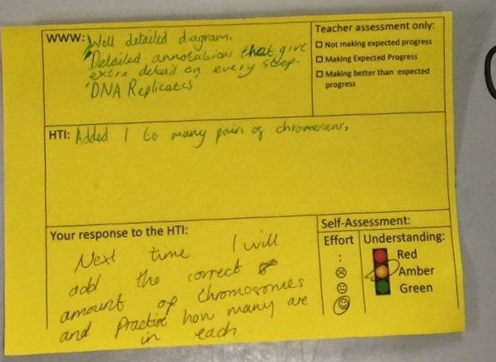
Formative Assessment
Longer answers
Notes:
An example of good practice in peer-analysis. WWW What Was Wonderful. HTI How To Improve. Many teachers like to use the ‘2 stars and a wish’ approach, in which the student who is doing the analysing finds two good points about the work (2 stars) and identifies one way in which the work could be improved (the wish). There are lots of variations on this idea.

Slide 37
Formative Assessment
Longer answers
Give comments rather than marks.
Encourage students to analyse answers for good and poor points.
Encourage students to assess other students’ work, in terms of good points and ways in which it could be improved (e.g. ’two stars and a wish’).
Notes:
Summary of ideas for using longer answer questions in a formative way.

Slide 38
Formative Assessment
Other ideas
Exit cards
Tweet what you’ve learnt (140/280 character limit)
ABCD cards or ‘Four Corners’ (real-time multiple choice)
Students write and swap own quiz questions (with mark schemes)
Traffic cards (red and green)
Post-It Note scatter graph (enjoyment vs confidence)
Venn diagrams (to compare and contrast ideas)
Notes:
Some other ideas of activities that work well for formative assessment. You can find details in some of the documents listed on the ‘Further reading’ slide.

Slide 39
Formative Assessment
Action Plans
clear aims
re-teach a concept in a different way (e.g. video, role play)
provide students with scaffolding (e.g. cloze, key words, sentence starters)
student becomes teacher
students write own action plans
wheel of improvement
re-test understanding using new contexts
students refine answers and say how
Notes:
Ideas for formative assessment action plans.
Scaffolding (third bullet) includes breaking down information into smaller chunks. For example:
• students identify key terms in a paragraph and you ensure that they understand those first
• give students a paragraph as a ‘fill in the missing words’ (cloze) exercise. Increase the difficulty by adding in words that the student does not need or do not provide any of the words
• give students a list of key words that they must use in an answer
• give students sentence starters or endings that they need to use in an answer
• break a paragraph down into bullet points
• give students the sentences from the paragraph and ask them to reassemble the paragraph in a way that makes sense.
Example wheel of improvement from Exploring Science: Working Scientifically (Pearson).

Slide 40
Formative Assessment
Notes:
Overall scheme developed for Edexcel 9-1 GCSE Sciences (Pearson) in order to embed formative assessment into the teaching.

Slide 41
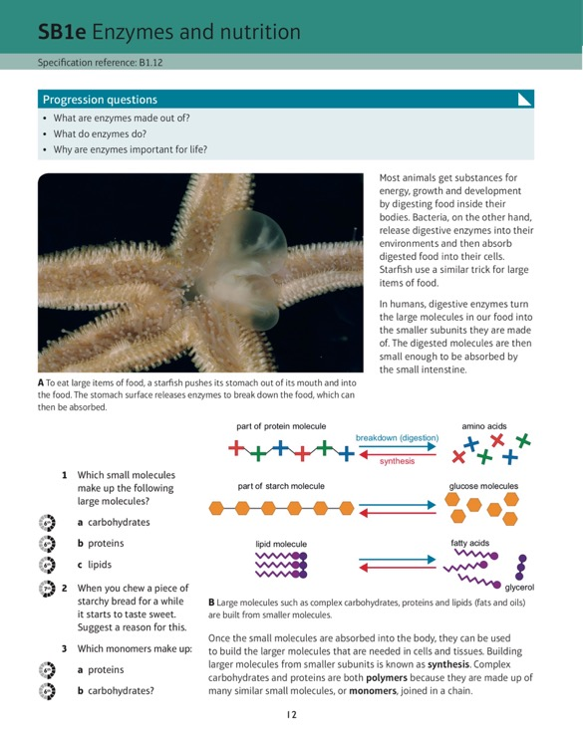
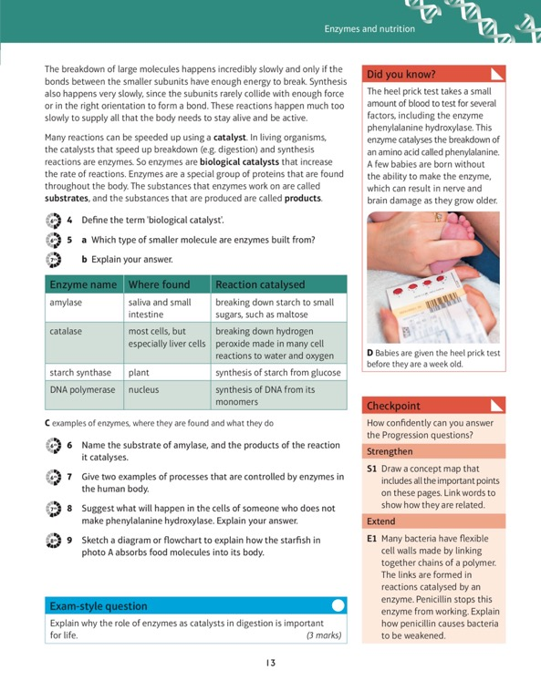
Formative Assessment
Notes:
Example ‘learning episode’ from Edexcel 9-1 GCSE Sciences (Pearson).

Slide 42
Further reading
Embedded Formative Assessment by Dylan Wiliam (ISBN 978-1934009307)
Tools for formative assessment www.levy.k12.fl.us/instruction/Instructional_Tools/60FormativeAssessment.pdf
Effective Questioning and Classroom Talk www.nsead.org/downloads/Effective_Questioning&Talk.pdf
What makes group working work? by Robert E Slavin http://library.teachingtimes.com/articles/what-makes-groupwork-work
Notes:
I would recommend this book by Dylan Wiliam.

Slide 43
Mark Levesley www.levesley.com @marklevesley

