Slide 1
Beyond 21st Century Skills through Science
Image by Mark Levesley
Mark Levesley
Freelance science
education writer
November 2019
1
Notes:
My name is Mark Levesley and I am a freelance science education writer based in the UK.
I’m very pleased to have been asked to talk to you today, and delighted to see you all here.
In the course of this session, I’m going to show you some things, and share some ideas but I’m going to be asking you to do some work too. For that, everyone will need the photocopied pack that looks like this and something to write with. And at the end of the presentation, I will also give you details of where you can download the presentation (which includes my speaking notes).

Slide 2
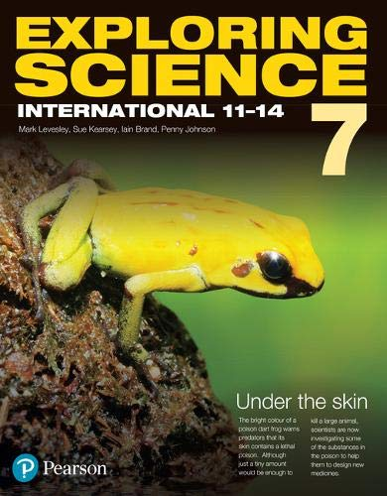
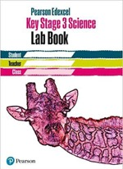
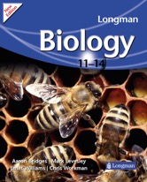
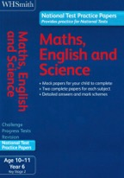
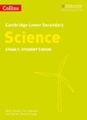
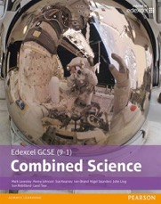
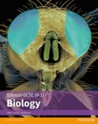
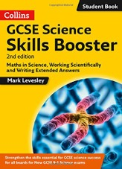
Introductions
Beyond 21st Century Skills through Science
Notes:
I wrote my first textbook in 1998 and have worked for most of the major UK publishers over the last 20 years, including Pearson, HarperCollins and Hodder. And here are some publications that I have worked on.
Apart from writing, I also act as series editor on many publications. One of my jobs as a series editor is to design how a course works. And that includes how the different subjects within science (biology, chemistry and physics) link together, the links between science and other subjects, and how to prepare students for their futures (both in terms of further study of science and their careers). And a lot of that last aspect involves skills development. And it’s skills development that I want to focus on today.
My subject is science, so the examples that I use will be drawn from science teaching, but if you teach other subjects (particularly maths or design and technology) a lot of what I’m going to say should be useful.

Slide 3
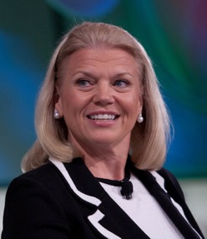
Predicting the future Careers
"So when it comes to education and skills … I'll hire for skills, not just their degrees or their diplomas”
Ginni Rometty, CEO of IBM
World Economic Forum in Davos, 23 January 2019
Beyond 21st Century Skills through Science
Notes:
For a moment or two, let’s ignore what we teach and think about why we teach. We teach in order to give students the best opportunities for their futures. We need to give students the skills that they are going to need to succeed in the world of the near future, and that includes the jobs that they go on to do. And it is skills (rather than factual knowledge) that are becoming increasingly important in the jobs market.
This is what Ginni Rometty, the chief of IBM said at the beginning of this year. [Click] [Read]
And the skills that companies are looking for today are changing incredibly quickly, as technology changes. To think about the speed of that change, it’s worthwhile noting that the iPhone was introduced 12 years ago. Since that time, smartphones have completely changed the way we live and work. And as teachers we need to try to predict what the future will hold, so that we can train our students effectively for their futures.

Slide 4
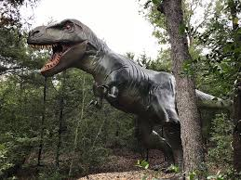
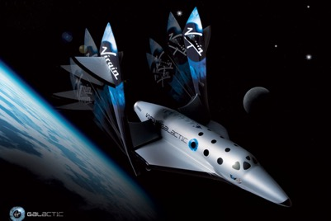
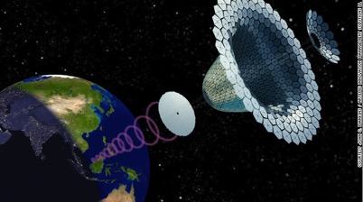
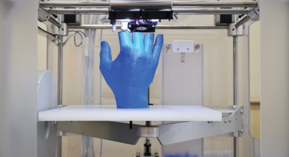
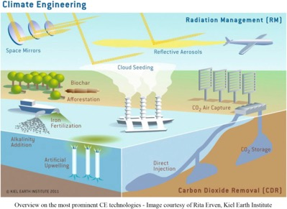
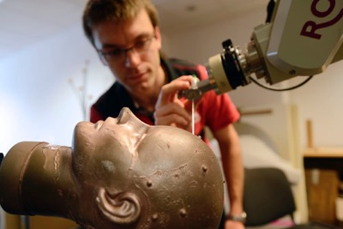
Predicting the future Careers
Suggest some jobs of the future,
that do not exist today.
Commercial space pilot
Extinct species revivalist
Alternative energy consultant
Organ or body part creator
Memory surgeon
Climate engineer
Beyond 21st Century Skills through Science
Notes:
So, let’s first of all thing about the future of the jobs market. I wonder whether we can think up some careers or jobs that do not exist at the moment but may exist in the future lives of our students. I’m going to give each table a minute to discuss some ideas and then I’ll ask for some suggestions. [Write ideas]
Commercial space pilot – there are various companies that seem to be nearing completion of projects to launch space tourism. Advances in DNA technology could result in a need for a new type of ecologist – the extinct species revivalist, perhaps in charge of a real life Jurassic Park. Alternative energy consultants could help develop new sources of energy. 3D printing and stem cell technologies could be combined to make it easier to create new organs for people. Depression and other mental health issues could be treated by changing people’s memories. Climate engineers could help it to rain in drier areas and change weather patterns to minimise the impact of climate change. Some of these ideas will sound plausible to us now, and others will seem a bit more unlikely … but I remember watching StarTrek as a boy and thinking that the ability to have a video conversation with someone using a device on your wrist was completely impossible.

Slide 5
Predicting the future Careers
PAST | FUTURE | SKILLS
Communication
Critical analysis and evaluation
Single career
Multiple careers
(often in parallel)
Beyond 21st Century Skills through Science
Notes:
It’s very difficult to predict the future and some of those jobs that we’ve just discussed will become a reality and some won’t. And there will be plenty more that we’ve not thought of that do become a reality.
But while it is very difficult to predict specific things that will happen in the future, we can look at what has happened over the last few decades and use that to inform us where we think things are headed – we’re looking to find some overall trends. So, I’m going to consider briefly how jobs and careers have changed, how I think they will continue to change and how that can help inform us about the skills that our students are going to need.
In the past, many people tended to enter one organisation or one career pathway and stay there. [Click] When I grew up in the UK in the 1970s and 80s, it became something of a joke that when you retired from your work after 40 or 50 years in the same place, you were given a carriage clock as a thank you bonus … and if you were very lucky a pen to go with it. [Click] Today, the workplace is much more dynamic and many people have more than one ‘job’ or ‘career’ and often those different careers are going on at the same time. There is less expectation that you will stay in the same career or at the some company for your entire working life. There has been an explosion of ‘contingent workers’ – these are freelancers, independent contractors, consultants, or other outsourced and non-permanent workers who are hired on a per-project basis. And I am one of those. A 2018 Deloitte report [Insights from IMPACT 2018] predicted that by next year 40% of the working population of the USA will be contingent workers.
So that’s my first trend. And I think that that trend will continue. So, how does that effect the skills that students are going to need? If you are going to have multiple jobs or careers, you are going to need to be good at communication [Click]. No longer can you pass an interview and then have a job for life. Now, you will need to prove yourself and your worth constantly – you will need the ability to sell yourself and your ideas is key. And you need to stay up with changes in technology and the ways in which people work, so you will need to be self-critical and evaluate your own working methods. [Click]

Slide 6
Predicting the future Careers
PAST | FUTURE | SKILLS
Critical analysis and evaluation
Use of maths
Slow retrieval
of information
Fast retrieval
of information
Beyond 21st Century Skills through Science
Notes:
My second trend revolves the speed at which we are able to access information.
Today we are surrounded by multimedia, computers, apps and the ability to obtain facts at the touch of a button. I’m going to predict that that change will continue, [Click] and our ability to retrieve facts will become quicker and quicker – a world in which we can talk to something like Siri on an iPhone and get all the facts that we want in an easily digestible manner. If my experiences with Siri are anything to go by, it has a long way to go! But going further than that, our phones might be able to tap into our brainwaves one day, and answer our questions before we’ve had time to formulate those questions. Eye implants may show you information in the way a heads-up display on a car does. While that all sounds a but sci-fi, I think that information retrieval – access to facts – will continue to get easier and quicker.
That doesn’t mean that students shouldn’t learn information. Today, students often say ‘But why do we have to learn this – I can just look this up.’ Students need to remember that even though we have all this easy access to information, innovation depends on people knowing things and then putting those things together in new ways. Those Eureka moments that people have are because they have made a new connection between different facts. If those facts were not stored in those peoples’ brains, those Eureka moments would not happen.
So, with a continual increase in faster and easier access to facts, and increasing quantities of data, how does that affect the skills that students need? Students are going to need to be fast at critically analysing data and making sure that it’s the correct data they need to answer a question or to do something, and also to make sure that the data can be relied upon. So, I think that critical analysis and evaluation skills are again key here [Click]. They are also going to need to process a lot of data, some of which is going to be numerical and so use of maths is another important skill [Click].

Slide 7
Predicting the future Careers
PAST | FUTURE | SKILLS
Generation and analysis
of data
Unchanging set of resources
Continuously changing
set of resources
Problem-solving
Beyond 21st Century Skills through Science
Notes:
My third trend is about the resources that are available to help someone carry out their job.
If you think about teaching as an example, in the past [click] there was an unchanging set of devices at our disposal – a black or white board, some scientific apparatus. And this didn’t change for decades. Having colour photographs in text books was a big thing back in the 90s. Today, the range of learning devices we have at our disposal is increasing rapidly, driven by the current technological revolution [Click].
Many jobs are now being affected by advances in artificial intelligence technologies (which includes things like speech recognition, machine learning and predictive analysis). And automation will also affect many jobs. That Deloitte report I mentioned earlier reckons that 35% of jobs in the UK, 47% in the USA and 77% in China are vulnerable to being replaced by some form of automation.
So students need to be quick at understanding what new technologies can do and how new resources can be best used to generate and analyse data to answer questions [Click]. They will need to be good at problem-solving and deciding which new technologies to use and how best to use them. [Click]

Slide 8
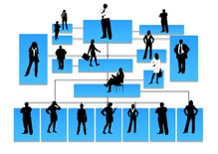
Predicting the future Careers
PAST | FUTURE | SKILLS
Innovation and invention
Hierarchical
More teamwork
Application of knowledge
Beyond 21st Century Skills through Science
Notes:
And my final trend is how companies and the workplace are structured. In the past, things have been very hierarchical [Click] – there has been a clear chain of command, in which those higher up the chain give fixed orders that are carried out by those further down. While this hierarchy is generally still in place, there has been a huge shift in the way that those higher up in a company listen to those lower down. There is a much greater emphasis on feedback, on team working [Click] and listening to one another. And because technology has been changing so rapidly, companies need workers who can take the initiative and adapt quickly to those changes as they occur.
So students will need to be more innovative and inventive [Click], and be able to apply their knowledge using independent thinking [Click] (rather than just relying on being told what to do).

Slide 9
Predicting the future Careers
PAST | FUTURE | SKILLS
Communication
Critical analysis and evaluation
Single career
Multiple careers
(often in parallel)
Use of maths
Slow retrieval
of information
Fast retrieval
of information
Generation and analysis
of data
Unchanging set of resources
Continuously changing
set of resources
Problem-solving
Innovation and invention
Hierarchical
More teamwork
Application of knowledge
Beyond 21st Century Skills through Science
Notes:
I have identified four general trends in the jobs market here, but there others. And I have identified seven key skills that I think students will need in order to succeed in this changing world of careers. While I have highlighted different skills as being required to meet the demands of different trends, I think you can probably see that many of those skills will apply to more than one of the trends.
So this is my list of seven key skills. And science is uniquely positioned to deliver training in all of those skills. And you may think “Well, I already do many of these” … and you would be right.
I also think that those seven key skills are common to other subjects, particularly the STEM subjects – so that is science, technology, engineering and maths. Many of these skills will be developed in many different subjects, but I think that all the STEM subjects develop and require all of these skills. So, I’m going to refer to these seven skills as STEM skills.

Slide 10
Key skills The seven STEM skills
Communication
Critical analysis and evaluation
Use of maths
Generation and analysis
of data
Problem-solving
Innovation and invention
Application of knowledge
Beyond 21st Century Skills through Science
Notes:
Now, I suspect that you have seen lists of skills like this before. [Click] So here, for example, is what the Edexcel International GCSE specification calls ‘transferrable skills’. So we have critical thinking at the top, problem-solving, analysis, reasoning etc. etc. This is really just a more broken down version of the seven skills that I have been talking about. And here for comparison is the list of skills in Cambridge’s IGCSE specification [Click] and we can see that the same things come up again – problem solving, communication, inventiveness. [Click, click, click]
So, the skills I’ve talked about as being important for students in their careers are also in the exam board’s syllabus documents. The examiners realise the importance of these skills. It’s not just me or the head of IBM who think that we need to help students to develop these skills in a more formal way.

Slide 11
Key skills Teaching the seven STEM skills
Application of knowledge
Innovation and invention
Problem-solving
Generation and analysis of data
Critical evaluation
Use of maths
Communication
Problem-solving
Beyond 21st Century Skills through Science
Notes:
Looking at these skills, we are all aware that there are many different aspects of each one, which is essentially why the Edexcel table on the previous slide was so long. For example, there are thousands of different ways in which you can do maths. And we can communicate by writing, in diagrams, by talking to one another etc. etc. So each of these STEM skills are broad titles for a whole array of different ‘competencies’ (or things that you can do).
When we talk about students developing one of these skills, what we mean is that they are developing additional ways of doing something; they are developing further ‘competencies’. [Click] Think of each skill as being a toolbox, and as students develop a STEM skill, they are adding more tools to that particular toolbox. And so, when a student is faced with a situation that demands problem-solving (for example), a student with more tools in his or her ‘problem-solving toolbox’ is better equipped to solving a broad range of problems and so more likely to solve any given problem. And having a broader range of tools to use for a skill, also makes it more likely that students will find the tools that best suit their own ways of working.

Slide 12
Key skills Teaching the seven STEM skills
Application of knowledge
Innovation and invention
Problem-solving
Generation and analysis of data
Critical evaluation
Use of maths
Communication
• Do your students know that they are developing these skills?
• Do your students have an understanding of why these skills are important for their futures?
• Does your Scheme of Work have a coherent plan for developing these skills?
Beyond 21st Century Skills through Science
Notes:
And I know many of you will be sitting there and thinking ‘I really don’t have time to get through the whole of the syllabus and teach even more of these skills as well.’ The good news is that you already teach many of these skills because most of them are part and parcel of science and maths. But do your students [Click] know that they are developing these skills, [Click] do your students have an understanding of why the skills are important and [Click] does your scheme of work have a coherent plan for developing these skills?
These I think are often questions that need to be asked and areas that need to be worked on. And the answers to them do not necessarily need to take up a whole load more time and effort.

Slide 13
Key skills Teaching the seven STEM skills
Agree and use common language about STEM skills in science and maths (and design & technology).
Introduce more exploratory classroom activities, which involve STEM skills.
Use examples with clear links to the uses of STEM skills (including careers).
Application of knowledge
Innovation and invention
Problem-solving
Generation and analysis of data
Critical evaluation
Use of maths
Communication
Beyond 21st Century Skills through Science
Notes:
So let’s think about how we teach these skills. I’m going to now run through three simple ideas that I think help to teach those skills without adding too much time to your already heavy workloads.
First, I’m going to suggest that the science department in your school sits down with the maths department (and the Design & Technology department, if you have one). Teachers in all those departments need to agree a common language to use in their lessons about STEM skills. I’ve given you what I think are the seven core STEM skills and some words of explanation. But you and your colleagues may come up with slightly different wordings. Sitting down and discussing the wording is a good idea, to make sure that all teachers are able to agree a common approach to the skills and agree a common set of skills, which everyone understands. And then STEM skills development within a science or maths class simply involves highlighting to students the STEM skills that they are meeting. [Click] If teachers of maths, science and design & technology can all use the same set of STEM skills, call them by the same names and refer to them as STEM skills while teaching, this helps students understand the links between the different subjects and the importance of these skills. It’s a simple matter of changing some of the language you use; making students familiar with the skills, highlighting them as you meet them and explaining to students that they are doing an activity in a certain way because it is developing an important skill.
In terms of students developing the set of skills (adding tools to each skills toolbox) … this is what we are going to look at in a minute: some activity ideas, focussed on STEM skills. But the general idea is to think about making some of the activities you already do, more active and more exploratory, and less guided. So that students have to find out more for themselves, rather than just being fed instructions. [Click] Remember that employers are after people who can think independently rather than just recall information.
And my third point is to think about the examples and contexts you use in your teaching. [Click] Highlight to students how STEM skills are used in a variety of contexts, both in terms of everyday modern life and in terms of possible careers and opportunities that are open to people with well-developed sets of STEM skills. So, in summary, here are three simple ways of helping students to develop these skills:
I've already talked about the first one, so let's now look at some activity ideas.

Slide 14
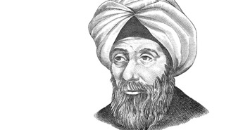
Some STEM skill activities 1. Communication
Communication
Beyond 21st Century Skills through Science
Notes:
In the photocopies that you should have in front of you, you’ll find a sheet that looks like this. We’re going to do a brief activity on the Scientific Method, that great foundation of modern science that was developed by Hasan Ibn al-Haytham [Click] in the Golden Age of Arabic Science. What I want you to do is to construct a way of showing the scientific method. I’d like you to work in groups of two or three or four. And don’t worry about being neat or worry to much about what you think I’m expecting. There is no one correct answer. This is about being ‘exploratory’ in your thinking.
[5 mins]
OK. [General discussion on who has used arrows as a flow chart, or a timeline or a life cycle or numbered sequence or lettered sequence] There are different ways of showing this information but in all those different ways we’ve communicated a sequence, using arrows or numbers or letters or a list to show an order in a simple to understand fashion. We could have written about the scientific method in a paragraph along the lines of ‘The first thing a scientist does is to … and then a scientist would … ’. But a diagram is much better of relaying information quickly and clearly than long paragraphs of text. Communicating information in a clear and concise way is a key STEM skill. And of course, in your group discussions about how best to draw this diagram you have also been communicating with one another. And so when you ask students to produce diagrams get them to work in groups and make sure they know that, as well as doing science, they are developing a STEM skill; students will get more out of a diagram drawing activity if a) it is more exploratory (and students have think for themselves) and b) they know that the activity is also about developing a key STEM skill - communication.
So consider making more use of diagram-making activities such as the one we have just done, where you ask students to use certain labels, words or phrases and construct a diagram,
Or give students a diagram, without any labels, and ask them to label it to explain something.
Or get students to produce diagrams that communicate information given to them in a paragraph (for example, one from a text book).
Or ask them to think about a concept that they have just learnt about and explain it in a diagram using as few words as possible. You could even challenge them to show the information as it would appear in a set of IKEA furniture-building instructions, where there are no words.
When doing diagram-making activities in groups, all the students are using their ‘communication’ toolbox [Click] and in doing the activity, they are adding more ‘communication tools’ to this toolbox often learning from one another. [Click] And this type of activity, not only integrates the development of key communication skills, but often helps students to remember the information they are supposed to be learning.

Slide 15
Some STEM skill activities 1. Communication
Observation
Communication
Question
Application of knowledge
Use of maths
Problem-solving
Hypothesis
Innovation and invention
Prediction
Investigation
Generation and analysis of data
Data
Does the data match the prediction?
Critical evaluation
Hypothesis supported
Beyond 21st Century Skills through Science
Notes:
So that’s an activity on communication. And while on the subject of the scientific method, we can highlight to students all the other STEM skills as we meet them.
This is just one version of a diagram to show the scientific method. It’s not necessarily the best one but in coming up with any diagram to show a process, we develop communication skills [Click], and use sequencing of numbers or a flow chart or a table which involves use of maths [Click for maths].
In terms of the scientific method, my answer is this. [Click for filled-in chart] However, as we shall see in a minute, not all science is done strictly according to these steps, and all that we really mean by the scientific method is a process in which we generate a hypothesis that can be tested. The whole process of the scientific method is about how scientists solve problems [Click for problem solving]. And equally as we meet other steps in the process, we can highlight for students other STEM skills that they are using and developing, such as application of knowledge, and innovation and invention [Click for hypothesis] when it comes to constructing hypotheses. And our investigations are about the generation [Click for Investigation] and analysis of data, and of course [Click for critical evaluation] some critical evaluation has to go on too. And the more you think about this the more places you could highlight STEM skills within the scientific method. So, we already teach STEM skills in science …

Slide 16
Key skills Teaching the seven STEM skills
Agree and use common language about STEM skills in science and maths (and design & technology).
Introduce more exploratory classroom activities, which involve STEM skills.
Use examples with clear links to the uses of STEM skills (including careers).
Application of knowledge
Innovation and invention
Problem-solving
Generation and analysis of data
Critical evaluation
Use of maths
Communication
Beyond 21st Century Skills through Science
Notes:
… but we need to point them out and highlight them for students, and we need to use agreed STEM skills language [Click]. And we should look for ways to allow students to explore [Click] and develop independent thinking skills rather than just telling them what to do [Click].

Slide 17
Some STEM skill activities 2. Generation and analysis of data
Observation
Question
Hypothesis
Prediction
New hypothesis needed
Investigation
Data
Generate and
analyse data
No
Does the data match the prediction?
Yes
Hypothesis supported
Beyond 21st Century Skills through Science
Notes:
Let’s look at some ideas for teaching another skill – generation and analysis of data.
Many scientists use investigations [Click for reveal] much like the ones we use in school, where we change an independent variable and measure the changes in a dependent variable. If students are asked to design an investigation, they have a very narrow idea of how to design it to generate and analyse data – they often think that the ‘right’ answer has to involve physical variables that they can change, measure and control. Their ‘generate and analyse data’ toolbox is not very full. [Click for toolbox]

Slide 18
Some STEM skill activities 2. Generation and analysis of data
Beyond 21st Century Skills through Science
Notes:
For example, we might tell students that adding a metal to some copper sulfate solution will cause an increase in its temperature. [Click for image.] A scientific question from this observation might be ‘Do different metals cause different increases in the temperature’. A simple hypothesis then becomes ‘The temperature increase depends on the type of metal added’. We might predict ‘If I add some different metals to copper sulfate solution, then I will see different increases in temperature.’ Our independent variable is the one we change (the type of metal) and the dependent variable is the one that we measure (the temperature increase). We will then also control some variables (like the form of the metal, the starting temperature of the copper sulfate solution, the concentration of the copper sulfate solution, the mass of the metal etc. etc.). And we do our investigation. [Click for animation.]
This is all perfectly good science but we tend to hand-hold students all the way through the scientific method, essentially leading them to the answer we want them to give. In incorporating STEM skills, we should try to give less information to students and encourage them to work things out for themselves (often using group work followed by the teacher’s input). So, when doing investigations encourage students to design and plan work rather than just giving them instructions.
And many students think that all scientific investigations are done in the same way, in which one variable is measured as another is changed. But if students are challenged to think a bit deeper, they will realise that this cannot possibly be true. In medicine, for example, you can’t do experiments on deadly human diseases using humans because it is unethical.

Slide 19
Some STEM skill activities 2. Generation and analysis of data
Beyond 21st Century Skills through Science
Notes:
In paleontology, you can’t do experiments on the organisms because most of them have been extinct for a long time.

Slide 20
Some STEM skill activities 2. Generation and analysis of data
Beyond 21st Century Skills through Science
Notes:
In astronomy, you can’t remove a black hole to see how the lack of its gravitational pull now affects a galaxy.
Scientists working in these fields need to use non-experimental forms of hypothesis testing. In a non-experimental hypothesis test, a scientist predicts observations or patterns that should be found if the hypothesis is correct but they have no control over the variables. The scientist then collects and analyses data, seeing whether the predicted patterns are actually present.
[30 minutes to here]

Slide 21
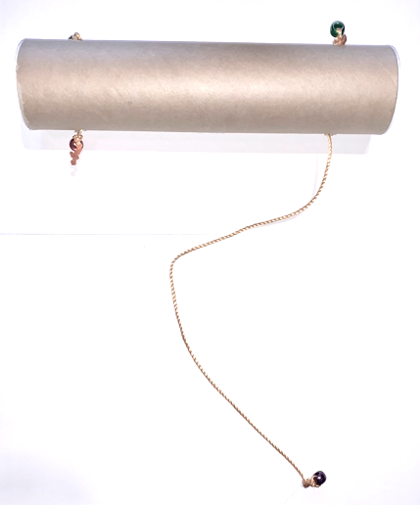
Some STEM skill activities 2. Generation and analysis of data
Your mission:
To come up with a hypothesis for what is inside your mystery tube and how the strings are connected.
Rules:
1 – You may not open the tube.
2 – You may not damage the tube.
Beyond 21st Century Skills through Science
Notes:
And there’s another common tool that many scientists use in investigations, to generate and analyse data. And we’re going to have a look at this now.
[Click for mystery tube] This is a mystery tube. I’ve got one here. It contains four strings, which move in and out of the tube when I pull them [demonstrate]. I’m handing around some mystery tubes now. I’d like you to work in groups of two or three and examine the mystery tube that you are given. You are going to try to work out what is in the mystery tube and how the strings are connected. But there are some rules: [Click for rules]
You may not open the tube.
You may not damage the tube in any way.
I will also say that not all of the mystery tubes are the same.
I’m going to give you a few minutes to come up with some ideas.
OK, times up. Let’s hear some of your hypotheses. [Call out for some ideas.]
Great. There are some excellent hypotheses out there. What can we do now to check if our hypotheses are correct?
[Feedback] Yes, we can make a model.
[40 minutes to here]

Slide 22
Some STEM skill activities 2. Generation and analysis of data
Your mission:
To build a model that can explain how your mystery tube works.
Rules:
1 – You may not open the tube.
2 – You may not damage the tube.
Beyond 21st Century Skills through Science
Notes:
And I happen to have some equipment for you to use in these bags. So, I’m going to give you a few minutes to make a model to behave in the same way that your mystery tube does. You won’t need all the equipment in each bag. And your model won’t look exactly like the mystery tube (for example, there are no end caps and there is no real need to use the coloured beads … they are just there on the mystery tubes to stop the strings disappearing through the holes).
[5 - 10 minutes]
I think that some of you have now got models that match the behaviour of the mystery tubes. While building the models, we’ve used a process of trial and error where we have constructed a model and then made predictions and then tested those predictions. When the predictions didn’t match the behaviour of the mystery tube then we went back and altered the model. In doing this we’ve generated and analysed data, we’ve also made observations which we have used to innovate and invent new versions of our model.
So, when faced with doing non-experimental forms of hypothesis testing, scientists often use models so that they can make changes to variables and they can do experiments in situations where this is not possible.
And you already teach using models like this. But do your students understand that they are using a model and why they are using it? This comes back to my point about making students aware of the STEM skills. Using models to generate data is another tool in our generation and analysis of data toolbox that sits alongside doing traditional physical experiments to generate data.

Slide 23
Some STEM skill activities 2. Generation and analysis of data
From Exploring Science: Working Scientifically Student Book 7
Beyond 21st Century Skills through Science
Notes:
Here's an example of a model that you teach - the particle model. And this model has been built up in the same way that you’ve built up your models of the mystery tube; making a model that behaves in the same way as our observations and which can be used to make predictions. The particle model of matter was constructed by scientists a long time before it ever became possible to investigate or see atoms and molecules. The model fitted all the evidence that earlier scientists had, and having worked it out they then used it to make predictions.
Einstein’s mathematical model of gravity fits all the observations and has been used to make predictions, such as gravitational waves. However, we still don’t know what gravity is … we still can’t look inside the ‘gravity mystery tube’. We just have to use our model.

Slide 24
Some STEM skill activities 2. Generation and analysis of data
From Exploring Science:
Working Scientifically Activity Pack 7
Beyond 21st Century Skills through Science
Notes:
Ecologists create food chains and food webs as models, which they use to make predictions and then they look for predicted patterns in a habitat when an event occurs … they don’t go out and kill all of a certain type of bird to see what happens. They still can’t change the independent variable … they have to wait for it to change.
In your photocopy packs, there’s a copy of this sheet [Click] which we aren’t going to do now but it gives you an example of building a food web model.
We use a lot of models in our teaching of science anyway; we just need to highlight some of the STEM skills that are being developed as we use and develop them.
And models are used in the technology that we use everyday, for forecasting the weather for example.

Slide 25
Some STEM skill activities 3. Problem-solving
Beyond 21st Century Skills through Science
Notes:
Let's look at another skill; problem-solving.
I’ve talked a lot about how new scientific theories are developed, and the STEM skills that that involves. But also think about putting in some STEM skill development when getting students to learn scientific ‘facts’ (‘scientific knowledge’). Thinking back to what I was saying about trying to do activities that are more active and exploratory, here’s one idea which looks at developing problem-solving skills.
In your photocopy packs, you should have something that looks like this: Organs of the alimentary canal. And I’d like you to have a go at doing that activity now. Feel free to work in small groups as you were doing. You’ll see that you don't actually need to know anything about the alimentary canal in order to complete this activity. All the instructions are on the sheet; it's a puzzle but I predict that many of you will not solve it.
[Pause for completion of activity]
So, in doing this problem-solving activity students are learning the order of organs in the gut … but in a way that is developing a STEM skill (which you can also point out to them) - how to put information in a logical order to solve problems. For some students it will help them to develop that tool if they can cut out the cards.
This example is designed to be used by students who don't know about the subject matter it contains; it's designed to teach them something in a more exploratory way. But these types of problem-solving puzzles can be used after students have learnt about something as well. And in your photocopied packs there are three examples of this for you to try. Each one generates a slightly different way of displaying some information and towards the end of your pack are the answers and a few words about the rationale behind using them.

Slide 26
Key skills Teaching the seven STEM skills
Agree and use common language about STEM skills in science and maths (and design & technology).
Introduce more exploratory classroom activities, which involve STEM skills.
Use examples with clear links to the uses of STEM skills (including careers).
Application of knowledge
Innovation and invention
Problem-solving
Generation and analysis of data
Critical evaluation
Use of maths
Communication
Beyond 21st Century Skills through Science
Notes:
So we’ve had a look at STEM skills, and some activity ideas that can be used to develop those skills when teaching science. There are plenty of activity ideas that you can use to introduce other STEM skills into your science teaching, but I would urge you to choose activities that deliver both the science and the skills. At the end of your handouts I have listed some useful websites for this.
What we haven’t done yet is to look at this last of my three ways of integrating STEM skills easily into your science teaching [Click]. Where you can, I would urge you to use examples and contexts with clear links to uses of STEM skills, both in everyday life and in terms of careers. This will allow students to start to understand why they are developing STEM skills and why they are so important. So, if you’re writing questions or making worksheets or designing a presentation for use by students, put in some examples that link to STEM skills (such as using the context of a STEM-oriented job).
Students need to see that developing these STEM skills may allow them to have opportunities that those without these skills may not get.
You may be using text books in your teaching, and it’s worthwhile highlighting links to STEM skills in those books, including the jobs people are doing. So, I’m just going to give you some examples from one of my courses, which some of you may be familiar with: Exploring Science.
https://undsci.berkeley.edu/
https://www.stem.org.uk/
https://practicalaction.org/schools

Slide 27
Key skills Teaching the seven STEM skills
Beyond 21st Century Skills through Science
Notes:
Exploring Science is designed for Years 7, 8 and 9 (so lower secondary). While its structure is based on quite a traditional double page spread format, it is full of photos and links between the science that students are learning, and the application of STEM skills in terms of activities, everyday life and careers,

Slide 28
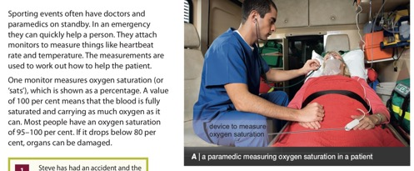
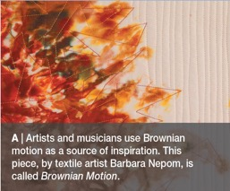
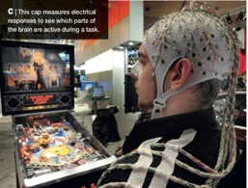
Key skills Teaching the seven STEM skills
Beyond 21st Century Skills through Science
Notes:
And here are some other examples from the books: we have a paramedic, a bit about archaeology, a water scientist, the development of games and even how some people have used scientific ideas to create art.

Slide 29
Key skills Teaching the seven STEM skills
Beyond 21st Century Skills through Science
Notes:
Various pages in the books are devoted to exploring the links between science and other subjects, so technology on this page on the left and art on this page on the right.

Slide 30
Key skills Teaching the seven STEM skills
Beyond 21st Century Skills through Science
Notes:
There are also pages that help to develop specific STEM skills. This one is obviously all about the use of maths.

Slide 31
Key skills Teaching the seven STEM skills
Beyond 21st Century Skills through Science
Notes:
And then there are pages that explore how STEM skills are applied in certain jobs. This one is about the work of food technologists …

Slide 32
Key skills Teaching the seven STEM skills
Beyond 21st Century Skills through Science
Notes:
… and this one is a career that doesn’t yet exist but goes back to our discussion at the start of the presentation – the work of a weather control engineer.

Slide 33
Key skills Teaching the seven STEM skills
Agree and use common language about STEM skills in science and maths (and design & technology).
Introduce more exploratory classroom activities, which involve STEM skills.
Use examples with clear links to the uses of STEM skills (including careers).
Application of knowledge
Innovation and invention
Problem-solving
Generation and analysis of data
Critical evaluation
Use of maths
Communication
Beyond 21st Century Skills through Science
Notes:
That brings me to the end of what I wanted to share with you. In summary, I hope that I have given you some things to think about in terms of what STEM skills are, their importance and how they can be integrated reasonably easily into your existing teaching of science.
For me, there are three key things that need to be done in order to incorporate the teaching of STEM skills effectively into the teaching of science. [Click]
And in doing this students should be able to develop the seven [Click] core skills that will enable them to flourish in an increasingly technological society.

Slide 34
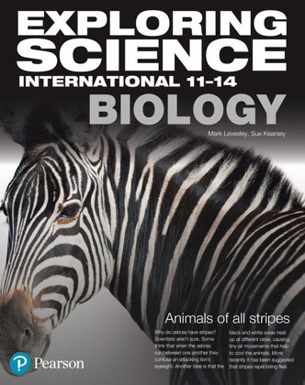
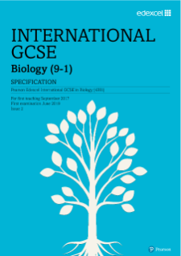
Key skills Teaching the seven STEM skills
Beyond 21st Century Skills through Science
Notes:
It’s important to remember not to leave teaching of these skills until students start studying for International GCSEs or the equivalent. Make sure that your Scheme of Work has these skills embedded into it in primary school and from the very beginning of secondary school. And in the same way that your Scheme of Work will have a carefully-paced development of scientific knowledge and ideas, it should also have a carefully-paced development of skills. That’s where a commercially published course, such as Exploring Science, can come in useful, where that carefully-paced development of both subject matter and skills has been done for you.
And while I’m talking about Scheme of Works of work, in the case of many secondary schools those five years of lower secondary leading up to International GCSEs should be viewed as one unit, with subject matter and skills development all leading up to those final exams. In that way, much of the material needed for International GCSE will have been covered earlier in secondary school and so there should not be a panic in the two years leading up to those exams. I’ve done a short analysis of Exploring Science and Edexcel International GCSE Biology. There are 176 statements in the International GCSE but nearly 100 of those are covered in Exploring Science International 11 – 14 Biology.

Slide 35
Further information
Instructions for mystery tubes at:
https://undsci.berkeley.edu/lessons/mystery_tubes.html
Useful websites for finding STEM skill activities:
https://undsci.berkeley.edu/
https://www.stem.org.uk/
https://practicalaction.org/schools
@marklevesley
www.levesley.com
Beyond 21st Century Skills through Science
Notes:
Here are a few websites that I think you might find useful, and some ways to stay in touch with me. All this information is also at the bottom of your handouts.
Very many thanks for working so hard!

